Slide 1
House Price Prediction Project
By Yunus Surty

Slide 2
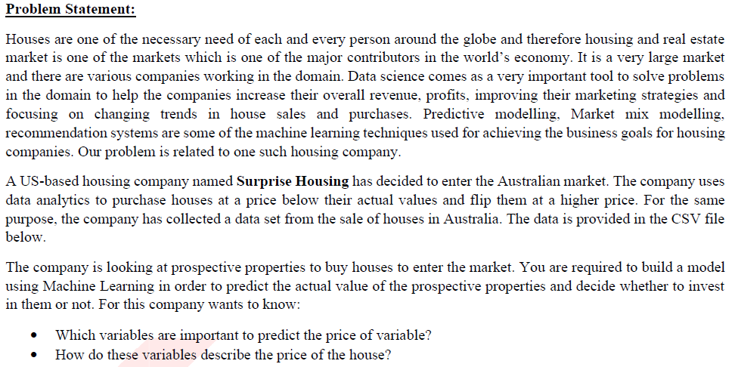
Problem statement

Slide 3
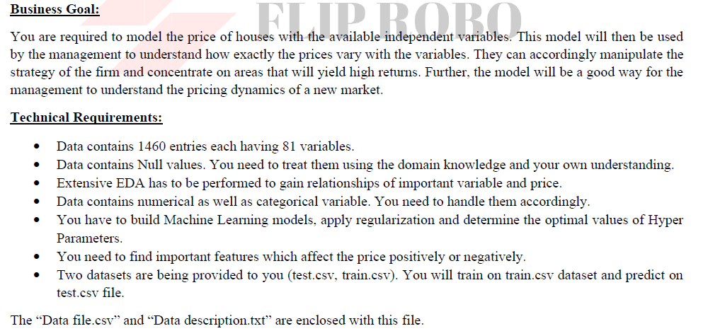
Business Goal & Technical requirement

Slide 4
Steps taken
Identified that this is a regression problem and we have to build a regression model to predict the price.
Data has Null values which was cleaned and was replaced with the appropriate values
Data Visualization helped us to understand the relationship between each feature against the target variable
Data was highly skewed because of the present of outliers

Slide 5
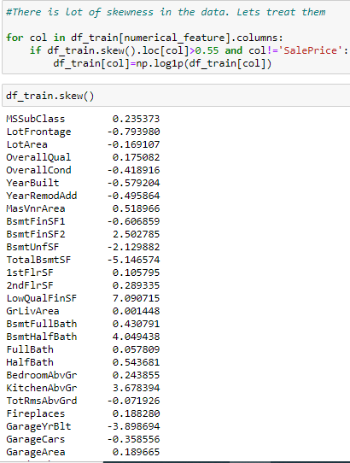
Steps taken
Skew was removed using log transformation method

Slide 6
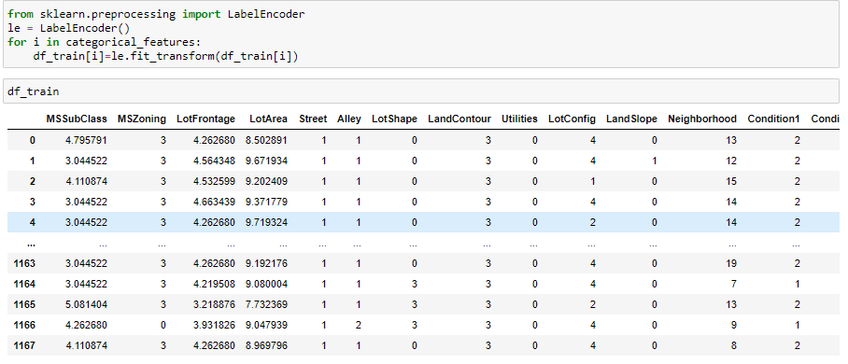
Steps taken
Categorical feature was converted to numerical feature using Label Encoder

Slide 7
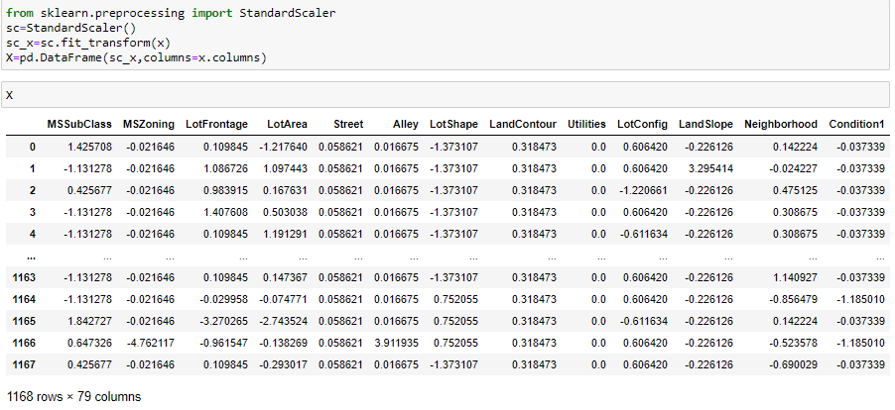
Steps taken
Data was standardised using Standard Scaler

Slide 8
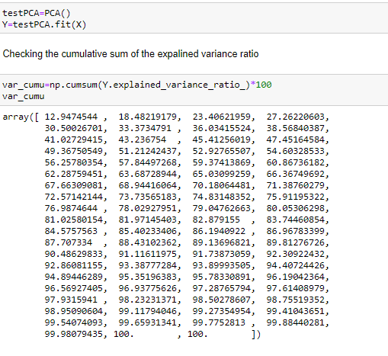
Steps taken
To avoid Multi collinearity, PCA was used to reduce the dimension of the data

Slide 9
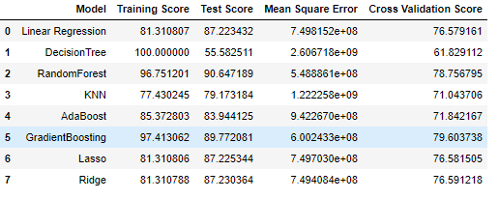
Model Selection
We used various algorithm to train the model. However the model was selected based on the R2 score and MSE performance.

Slide 10
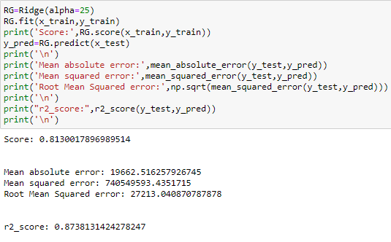
Hyper Tuning
With R2 score of 87% and RMSE of 27213 we selected Ridge regressor as our final model after Hypertuning

Slide 11
Conclusion
KEY FINDINGS AND CONCLUSIONS OF THE STUDY
In this project we have tried to show how the house prices vary and what are the factors related to the changing of house prices. The best(minimum) RMSE score was achieved using the best parameters of Ridge Regressor through GridSearchCV though Lasso Regressor model performed well too.

